Slide 1
Morphology of foraminifera
By
Muhammad Rizwan
Department of Geology
University of Swabi

Slide 2
Chamber Shape and Arrangement
There is a great variety in the test shape and styles of chamber arrangement of foraminifera.
On the basis of chamber, foraminifera may be
Unilocular
Multilocular
Unilocular foraminifera are composed of a single chamber and posses an open end called as aperture. there may be no apparent opening in some globular and hemispherical attached forms, while in others there is a definite, restricted, consistently placed opening.
Multilocular foraminifera are composed of more than one chamber and divided by septas.

Slide 3
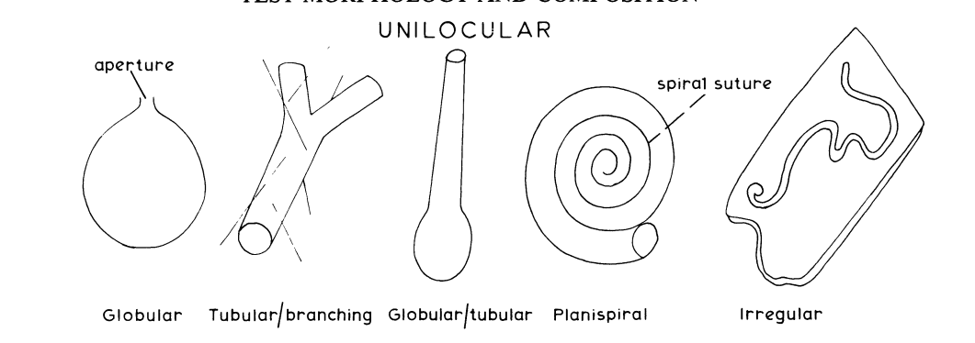

Slide 4
Multilocular
More than one chamber.
The initial chamber is most often spherical or oblate with an aperture. Later chambers range in shape from tubular, spherical, ovate to the several others.
Additional chambers are added in a variety of patterns termed chamber arrangements.
Different chamber arrangements are
uniserial, biserial, triserial
Planispiral
Trochospiral
Annular Discoidal
Annular Complex

Slide 5
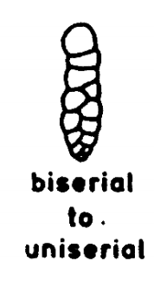
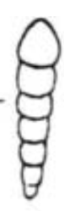
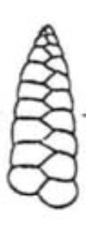
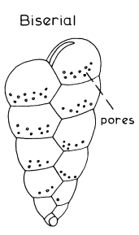
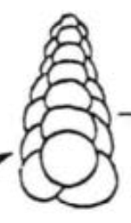
Uniserial: The simplest form of multilocular arrangement in which the chambers are arranged in a single series/row, either rectilinear (if it forms a straight series) or arcuate (if it forms a curved row).
Biserial: Chambers are arranged in two alternating rows.

Slide 6
Coiled Arrangement
When a series of chambers is arranged spirally or coiled about an axis, the chambers involved in one complete revolution are termed a whorl, or coil. 1. Planispiral: In this type of arrangement the series of chambers is coiled in a single plane.
Evolute: if majority of previous coils are visible i.e. chambers of each turn (whorls) only touch the periphery of the preceding whorls
Involute: The degree to which one whorl covers, or hides a previous one, is known as the degree of involution.
Chambers of each turn (whorl) embrace/hides the previous whorls.
Symmetrical coiling i.e. may be either Planispiral evolute or Planispiral involute.

Slide 7
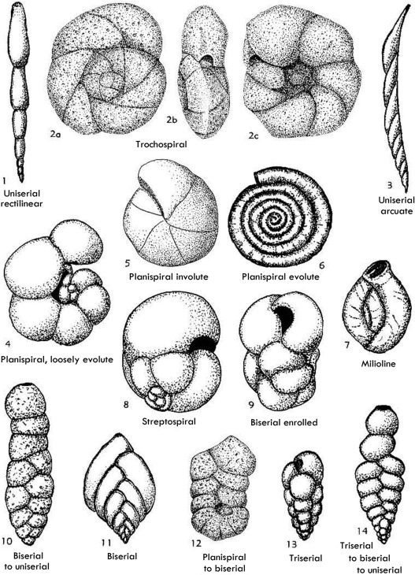
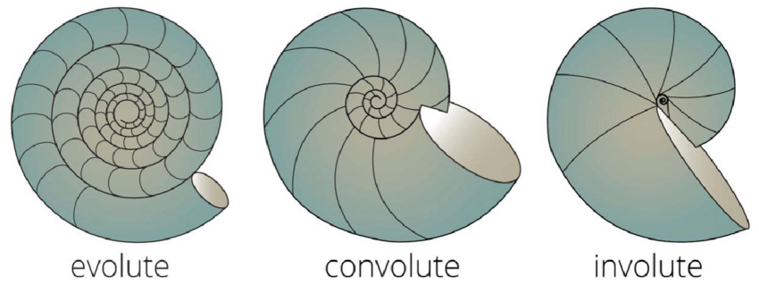
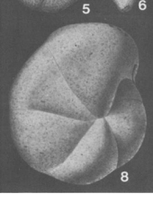
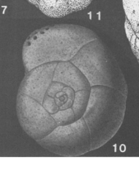

Slide 8
2. Trochospiral:
When the spiral does not lie in one plane, but progresses up the axis of coiling, the chamber arrangement becomes helicoidal and is termed trochospiral.
On a coiled test the side of the foraminifer showing the trace of the coil, or spiral, is termed the spiral side.
The opposite side is termed the umbilical side i.e. involute side in trochospiral foraminifera, with only chambers of the final whorl visible.
umbilicus space at inner margins of chambers on umbilical side of test.
Asymmetrical type of coiling i.e. the upper side (dorsal) is evolute, and the inner side (ventral) is involute.
If umbilicus is filled, then called as umbilical plug.

Slide 9
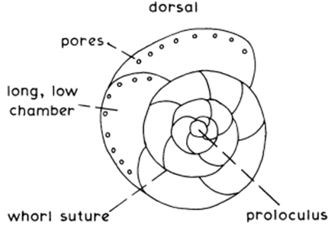
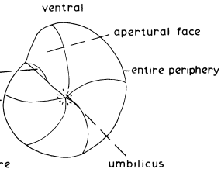
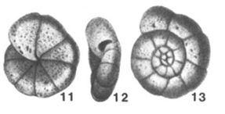

Slide 10
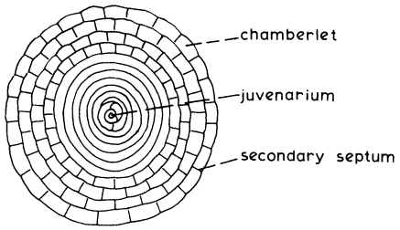
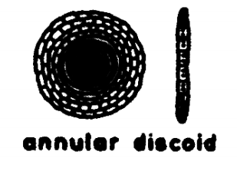
Annular Discoidal
The initial chambers are planispiral and the later ones added as annular rings (concentric).
The ring-like later chambers are commonly subdivided by secondary septa into chamberlets.

Slide 11
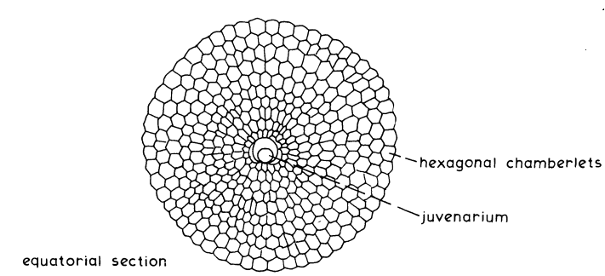
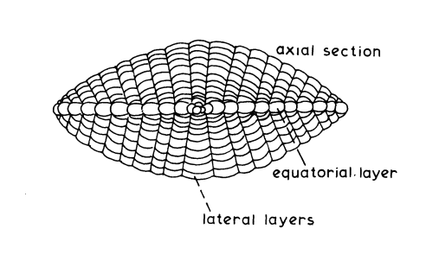
Annular Complex
They have annular discoidal 'equatorial' layer and layers of lateral chamberlets on each side, giving a generally flattened spheroidal shape.
They have two layer of chamberlets i.e. equatorial layer and lateral layers

Slide 12
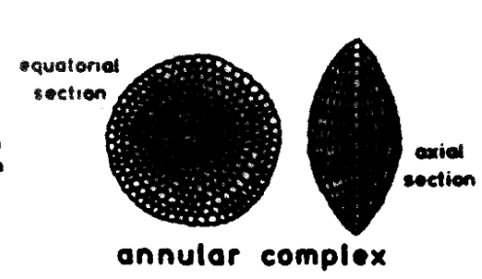
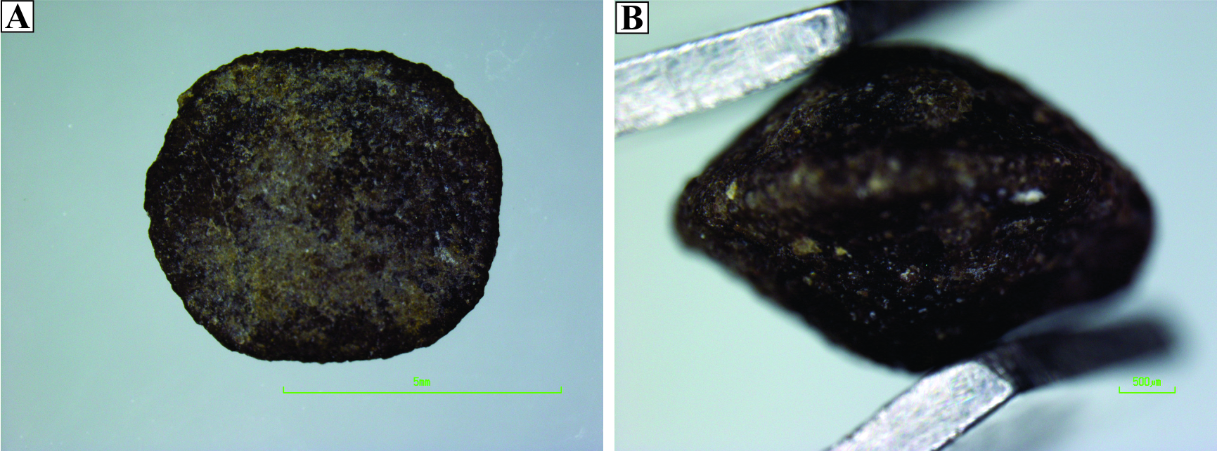

Slide 13
APERTURE AND THEIR TYPES
The aperture is the primary opening of the test to the outside environment.
Apertures vary in size and shape (Fig) and the shape is most often a function of the shape of the chamber on which they are located.
Three main types of aperture are;
Primary Aperture
Relict Aperture
Supplementary Apertures

Slide 14
Aperture and Their Types
1. Primary Aperture: Characteristically one aperture termed the primary aperture and distinguishes the apertural side of the foraminifer.
They may be terminal, areal, basal, extra-umbilical or umbilical.
Their shape varies widely, for example rounded, bottle-necked (phialine), radiate, dendritic, sieve-like (cribrate), cruciform, slit- or loop-shaped.
e.g. Eocene planktonic genus Globigerinitheca
2. Supplementary Apertures: when two or more apertures occur on a single chamber are termed as supplementary apertures
Notes:
Phialine: bowl or saucer shaped

Slide 15
3. Relict Aperture:
The aperture of a chamber that was once the final chamber of a test may remain visible after another chamber has been added.
e.g. Rotalipora

Slide 16
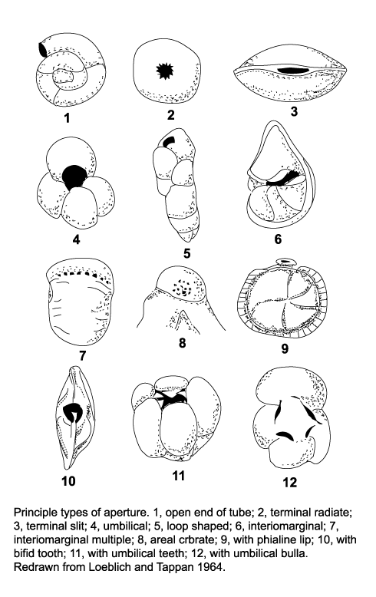
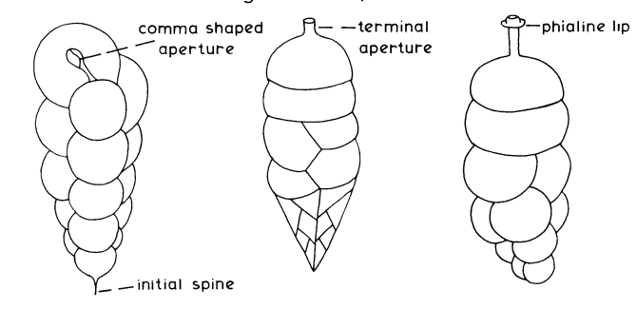
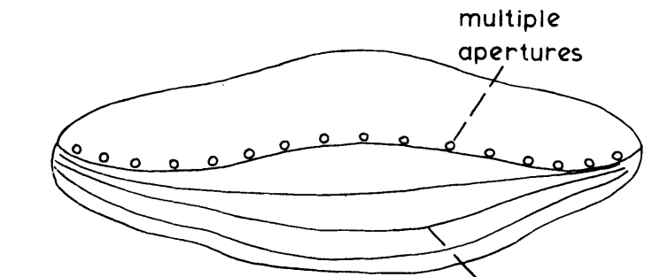
Open end of tube
terminal radiate
terminal slit
umbilical
loop shaped
Interio marginal
Interirio marginal multiple
Notes:
Phialine: bowl or saucer shaped

Slide 17
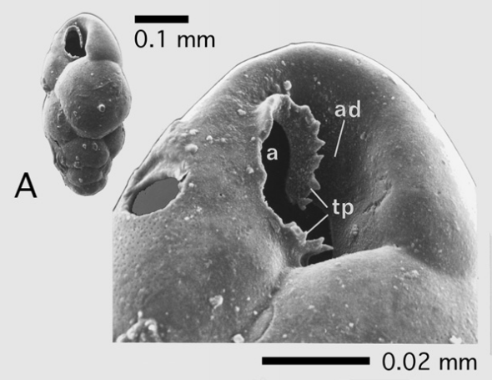
Toothplate
modification of the internal part of an aperture.
A toothplate connects one aperture with the preceding one and in many forms is a simple sort of tube or trough
adapertural depression: A depression between the apertural rim and the attached part of the toothplate.

Slide 18
OPENINGS WITHIN THE FORAMINIFERA TEST
1. Canal Systems:
In rotaliacea and Orbitoidacea canals are tabular cavities with in the shell material often between the two layers of a septal wall.
When the canal connects two chambers through a septum they are termed as stolons.

Slide 19
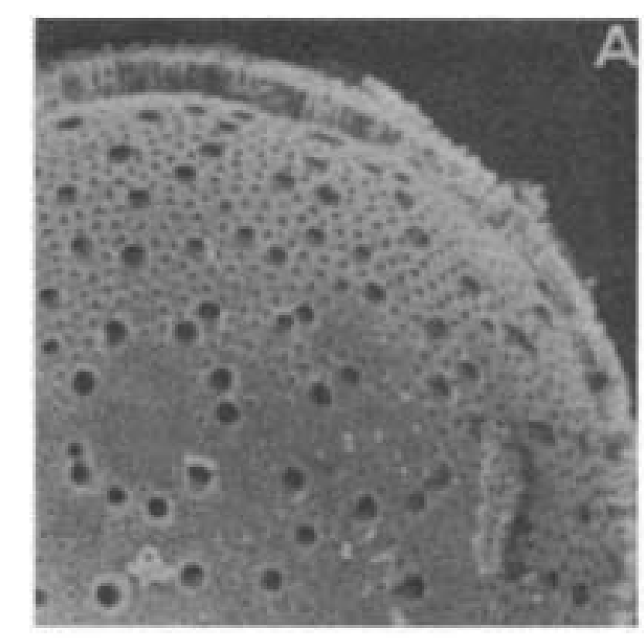
2. Pores:
Pores are round, sht-like, or irregular openings approximately 5 to 6 jum. in size.
They perforate the test wall.
Pores are typical of both agglutinated and hyaline Foraminifera and are one criterion differentiating these groups from the porcelaneous Foraminifera.

Slide 20
ORNAMENTATIONS
1. Spines
a calcite rod normal to the test surface, thin, round, triangular to triradiate in section, running through a hole in the outer lamella of planktic foraminifera.
Arises apparently from the median layer of the chamber wall. At its base it is surrounded by a more or less conical mound, the spine base
Notes:
Phialine: bowl or saucer shaped

Slide 21
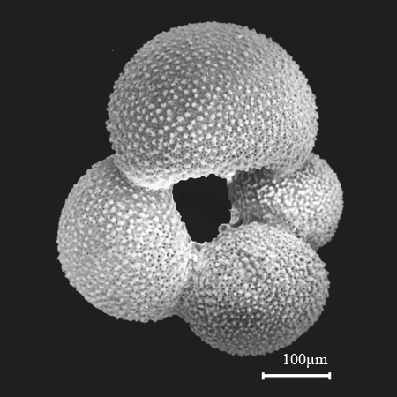
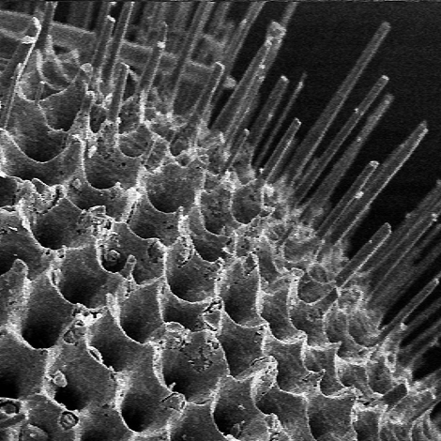
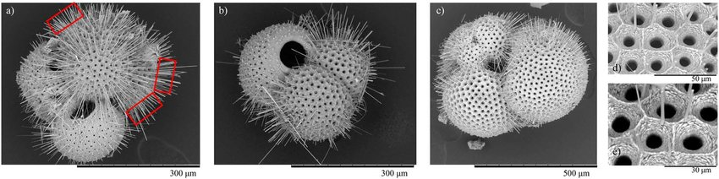

Slide 22
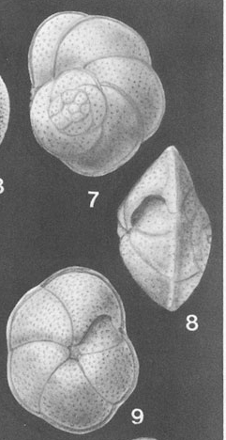
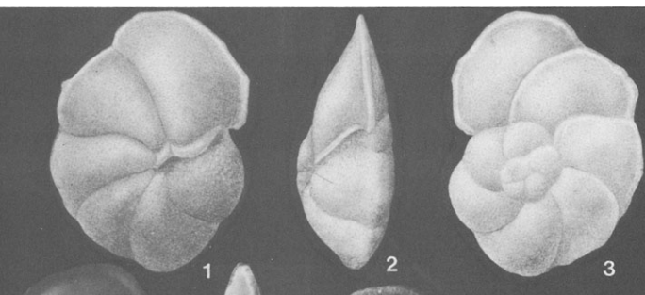
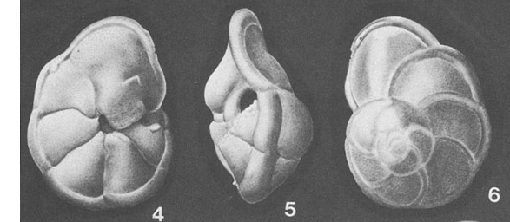
2. Keel
a peripheral thickening of the shell.
May be doubled in Cretaceous planktic foraminifera.
In bilamellar foraminifera formed exclusively by the outer lamella and therefore imperforate.

Slide 23
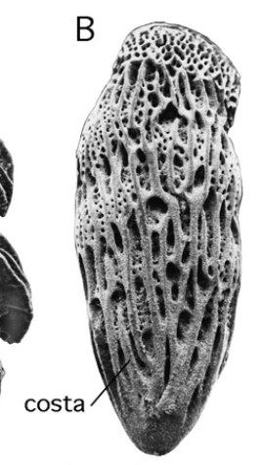
3. Costae
raised ribs or ridges on test surface.
Shells having costae are called costate.

